Slide 1
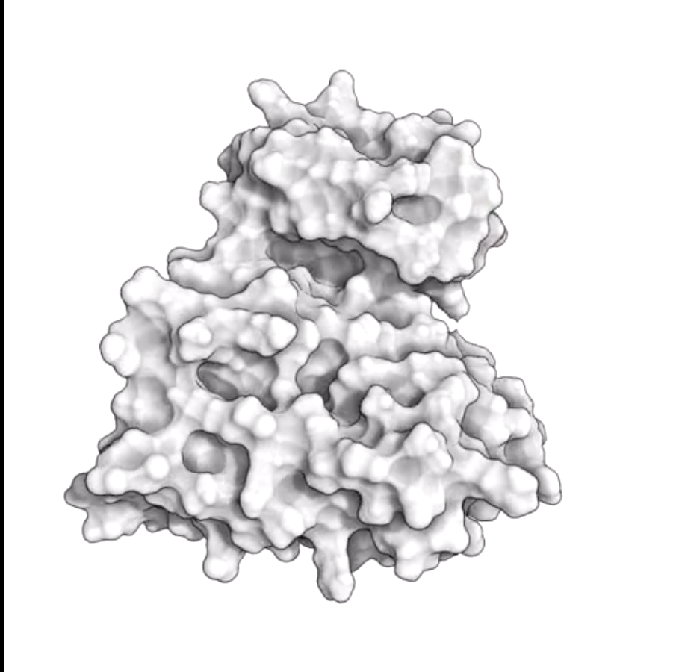
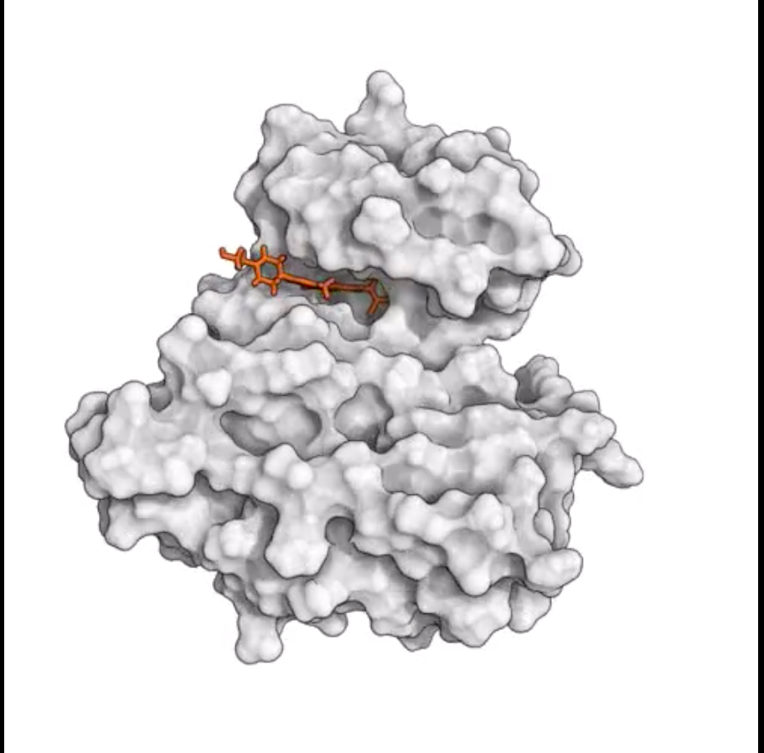
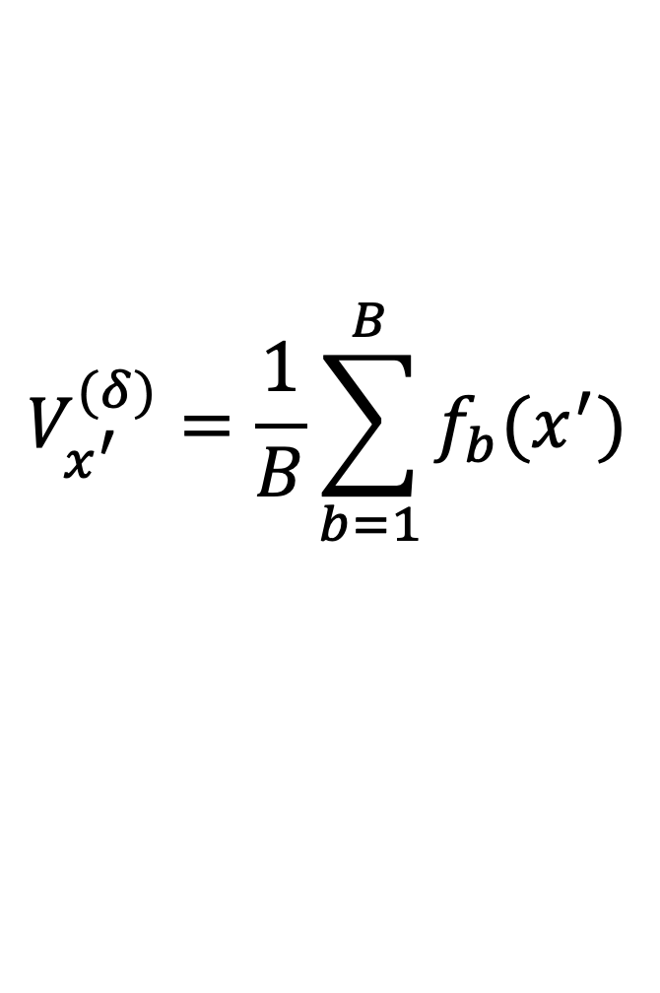
Protein binding pocket volume by Random Forest Regression
Jacob Levitt^{1,2}, Jessica Freeze², and Victor Batista²
$$V_{x^{′}}^{(δ)}=\frac{1}{B}\sum_{b=1}^{B}{f_{b}(x^{′})}$$
Equilibrium
Bound
Figure: Shan, Y., Kim, E. T., Eastwood, M. P., Dror, R. O., Seeliger, M. A., & Shaw, D. E. (2011).
How does a drug molecule find its target binding site?. Journal of the American Chemical Society, 133(24), 9181-9183.
¹ Yale University Department of Molecular Biophysics and Biochemistry
² Yale University Department of Chemistry

